Slide 1
International Innovation Corps
I N T E R N A T I O N A L
INNOVATION CORPS

Slide 2
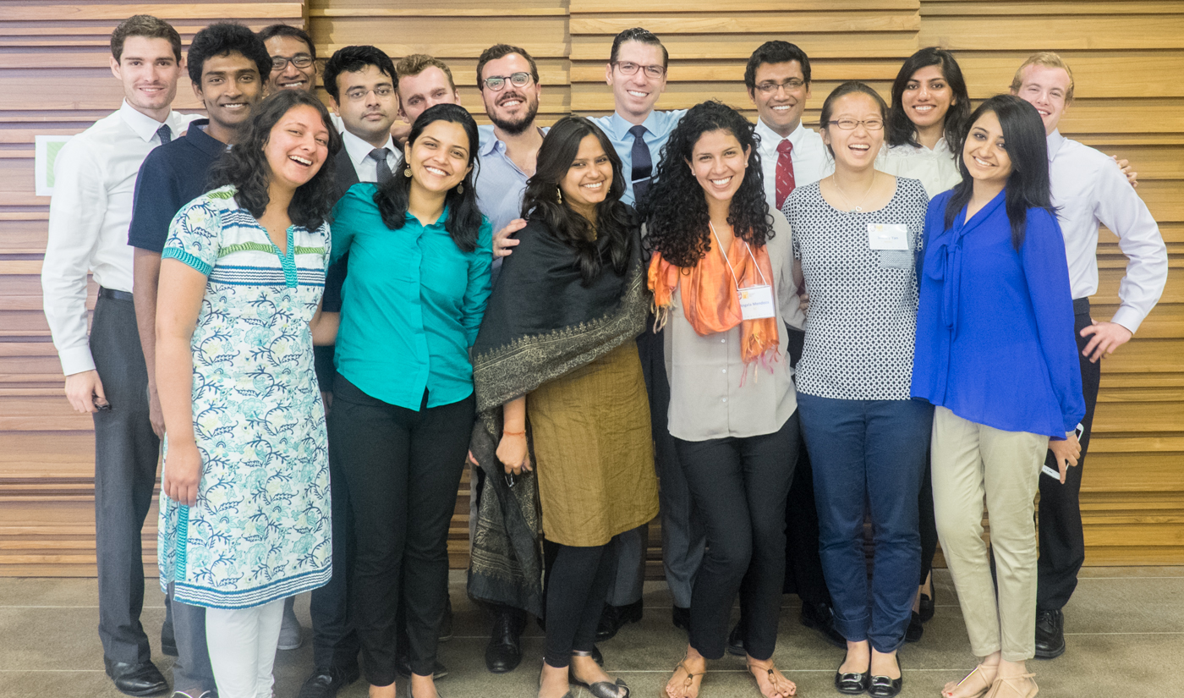
Challenging Innovative Minds to Solve the World’s Biggest Problems
The IIC is fellowship program at the University of Chicago Harris School of Public Policy, in partnership with the USAID Global Development Lab, that sends top-performing teams to work on priorities in Government of India.

Slide 3
A New Approach to Big Problems
India is the world’s largest democracy
yet lags behind almost all countries in many important human development metrics
India’s government officials want change
but many do not have the right mix of staff to tackle complex problems
The brightest graduates from top Indian and US universities want to address big social problems
yet few programs offer in-depth, collaborative opportunities
Conventional solutions to important development problems often yield slow success
so India must focus on the design and implementation of innovative solutions to these problems
Notes:
Can mention that NGOs and private companies typically work outside of government institutions, not within them as teams of IIC Fellows do; many pilots and good initiatives take place, but there’s not enough focus on scaling using the government.
4,000 IAS officers for a country of 1.2 billion.

Slide 4
An Innovative, Collaborative Model
IIC and in-country partners identify projects in government priority areas
IIC matches a diverse team of fellows to each project
Teams are embedded in partner institutions to develop sustainable solutions
IIC recruits fellows from top Indian universities and the University of Chicago
Fellows complete intensive training to become entrepreneurs, innovators, and collaborators
Projects leverage support from UChicago and USAID to produce lasting impact

Slide 5
The Right Human Capital Goes a Long Way
The IIC and partners select projects where human capital has critical value and small teams can make a difference.
The IIC fellows are top graduates from select universities with diverse perspectives, skills, and backgrounds who collaborate to generate the best new ideas.
IIC teams train with innovation experts at the Booth School of Business and Indian industry leaders, giving them the tools and contextual knowledge required to meet demanding goals.
IIC teams have access to the best resources available at one of the world’s top universities to empower them to take bold actions.
IIC teams work with their host partners to set ambitious goals for their projects and teams expect to work tirelessly to reach them.

Slide 6
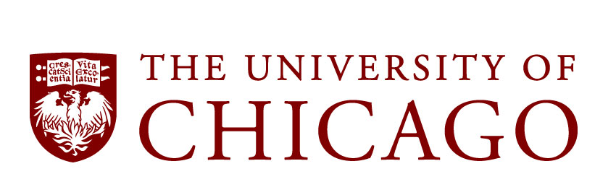
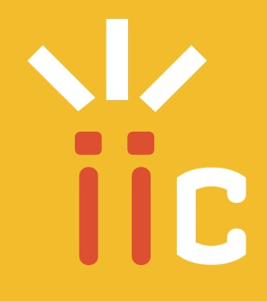
IIC Teams Supported by a Global Network
Harris School of Public Policy
Law School
Center in Delhi
Polsky Center for Entrepreneurship and Innovation
Chicago Innovation Exchange
Data Science for Social Good
Network of global innovators
Consortium of 6 university partners
IIC Team
Partners & Mentors

Slide 7
How Our Partners Support Our Teams
USAID’s Research and Innovation Fellowships connect our fellows to an extensive network of over 100 graduate fellows and hundreds of hosting organizations around the globe.
Through USAID’s Global Development Lab, fellows can access a multitude of tools and opportunities centered around science, technology, innovation and partnerships.
The University of Chicago Center in Delhi co-hosts the IIC’s quarterly Leadership Speaker Series, featuring prominent leaders in business and government.
Mentors from the Polsky Center for Entrepreneurship and Innovation and the Harris School of Public Policy lead rigorous training sessions and provide yearlong support to fellows.
Data Science for Social Good coaches fellows in cutting-edge data science methods and provides resources as needed from the University of Chicago Computation Institute.
Tata Trusts will share extensive domain knowledge and connect fellows with influential government and private sector stakeholders.

Slide 8
Leveraging University of Chicago Talent
CHRIS BERRY
Associate Professor, Harris School of Public Policy
MARIANNE BERTRAND
Chris P. Dialynas Distinguished Service Professor of Economics, Booth School of Business
KATHLEEN CAGNEY
Associate Professor, Departments of Psychology, Health Studies,
and Comparative Human Development
JONATHAN FRENZEN
Director, Management Labs, Booth School of Business
RAYID GHANI
Research Director, Computation Institute at the University of
Chicago Institute; Leader, Data Science for Social Good Fellowship
MELISSA GILLIAM
Professor of Obstetrics/Gynecology and Pediatrics, Pritzker School
of Medicine
TOM GINSBURG
Deputy Dean, University of Chicago Law School; Professor of
Law and Political Science
Michael Greenstone
Milton Friedman Professor in Economics and the College; Director
of the Energy Policy Institute at Chicago (EPIC)
COLLEEN GROGAN
Professor, School of Social Service Administration
Mark Lycett
Senior Lecturer in Anthropology and Social Sciences in The College; Director, Program on the Global Environment
ANUP MALANI
Lee & Brena Freeman Professor, University of Chicago Law School; Professor, Pritzker School of Medicine; Director, International Innovation Corps
LAURIE METS
Associate Professor, Molecular Genetics and Cell Biology
BOB ROSENBERG
Director of Entrepreneurship Programs, Polsky Center for Entrepreneurship and Innovation, Booth School of Business
FRANK SCHELL
Lecturer on South Asian Affairs, Harris School of Public Policy
OLEG URMINSKY
Associate Professor, Booth School of Business
Alessandra Voena
Assistant Professor in Economics and the College

Slide 9
IIC Projects Tackle Challenging Problems
Enable rural electrification through solar technology with Central Electronics Limited (CEL)
Improve conditions in urban sanitation work with Tata Trusts and the Municipal Corporation of Greater Mumbai (MCGM)
Plan and build integrated and sustainable charter cities with the Delhi Mumbai Industrial Corridor Development Corporation (DMICDC)
Partner with Tata Trusts, the Energy Policy Institute at Chicago (EPIC), and the Government of Maharastra to expand energy access and improve regulation
Design a social impact incubator for entrepreneurs with Millennium Alliance, the Federation of Indian Chambers of Commerce and Industry (FICCI) and the USAID Mission in India
Establish lasting job creating in the textile industry with the National Skills Development Corporation (NSDC)

Slide 10
Delhi-Mumbai Industrial Corridor Development Corporation (DMICDC)
PROJECT GOAL: The DMICDC-IIC team will plan an integrated and sustainable charter city in the Dadri-Noida-Ghaziabad Industrial Region in Greater Noida, to serve as a model for the 24 other charter cities to be built.
KEY PROJECT PARTNERS:
Talleen Kumar, CEO & MD, DMICDC
Abhishek Chaudhary, Company Secretary & Public Information Officer, DMICDC
Amitabh Kant, Secretary, Dept. of Industrial Policy and Promotion (observer)
IIC-DMICDC team is driving improvement in ease of doing business in charter cities.
FOCUS AREAS FOR IIC TEAM:
Design a streamlined regulatory process for opening businesses to cut through red tape and improve ease of doing business
Identify and sign a statement of interest with an anchor tenant
Craft an effective Greater Noida marketing campaign and organize an investor meet to launch IIT-Greater Noida tenders and improve public knowledge

Slide 11
Central Electronics Limited (CEL)
PROJECT GOAL: The CEL-IIC team is expanding the use of solar technologies to promote green electrification across India.
KEY PROJECT PARTNERS:
Nalin Shinghal, Chairman and MD, CEL
Atul Bhargava, CEL
IIC-CEL team is increasing demand for electronics or solar-powered technologies by bringing power to off-the-grid villages.
FOCUS AREAS FOR IIC TEAM:
Implement village-level solar powered micro-grids and metering technologies to fashion a workable renewable energy solution for rural environments
Develop standards for renewable energy use in green-field cities, akin to LEED standards

Slide 12
National Skills Development Corporation (NSDC)
PROJECT GOAL: The NSDC-IIC team will establish sustainable job creation and vocational training programs in India’s textiles sector.
KEY PROJECT PARTNERS:
Dilip Chenoy, MD & CEO, NSDC
Mahesh Venkateswaran, Principal – Innovation and Engagement, NSDC
Ministry of Textiles (observer)
New job opportunities created by IIC-NSDC team responds to companies’ demand for skilled workers.
FOCUS AREAS FOR IIC TEAM:
Work with several organizations across various states to establish standards for training centers
Foster partnerships between employers and job training companies to create an online labor information exchange database, matching workers with jobs in their respective sectors

Slide 13
IIC Plans for Growth
The IIC launched its first 3 projects in June 2014 with DMICDC, CEL, and NSDC.
In 2015-2016, the IIC will host 4-6 projects in India.
The IIC continues to seek new projects in the key areas of urban development, energy & the environment, health, innovation, and education.
In future years, the IIC plans to solidify long-terms projects in India and expand to working in other countries.

Slide 14
Thank you.
To learn more about the IIC, please visit iic.uchicago.edu
or contact Phoebe Holtzman, pholtzman@law.uchicago.edu.
CONNECT WITH US
facebook.com/internationalinnovationcorps
@innovcorps

